Slide 1
Raytracing
Version 2: Nov 13, 2017
Notes:
See the script here : https://docs.google.com/document/d/1K5NvSbPQWx8yGAFF6gtqmNwwStIQUjNpDVjL4rb4Viw/edit

Slide 2
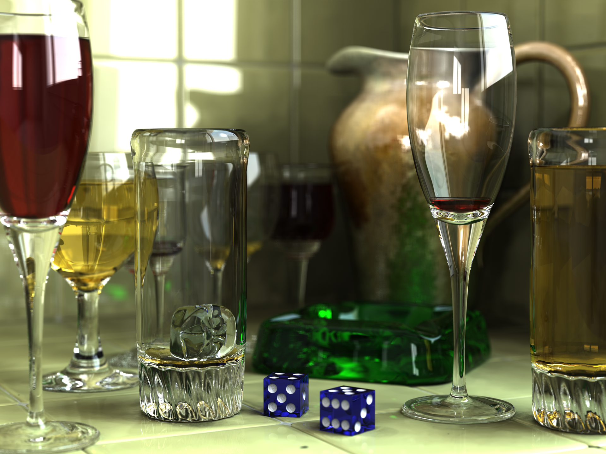
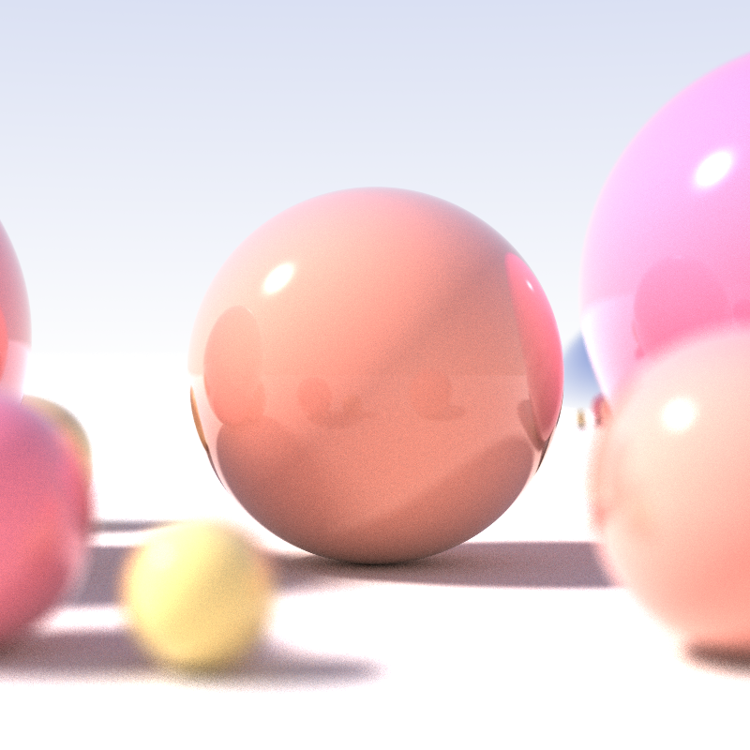
“One algo, we all knew of it, but no one had the guts to publish it.
Because it takes so long to do” [4]
[6]
Notes:
A very simple way to render a 3D scene
Conceptually easy to add advanced concepts such as shadowing and reflection
Very computationally expensive, initially was laughed at for the absurd resource requirements.

Slide 3
General Idea
Notes:
We have three types of things
A camera
A screen door
Some objects
Notice how the camera is in between the screen.
Consider each hole in the screen to be a pixel.
Then read “For each pixel … an object”.
Then say As soon as the ray intersects an object, set the pixel color based on the objects color..

Slide 4
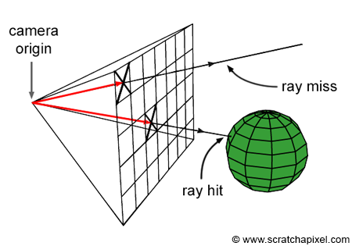


General Idea
Imagine a 3D area with types of a things.
For each pixel, send out a ray originating from the camera, going through that pixel in the screen, and continuing until a certain distance, or the ray intersects an object.
1+
[5]
Notes:
We have three types of things
A camera
A screen door
Some objects
Notice how the camera is in between the screen.
Consider each hole in the screen to be a pixel.
Then read “For each pixel … an object”.
Then say As soon as the ray intersects an object, set the pixel color based on the objects color..

Slide 5
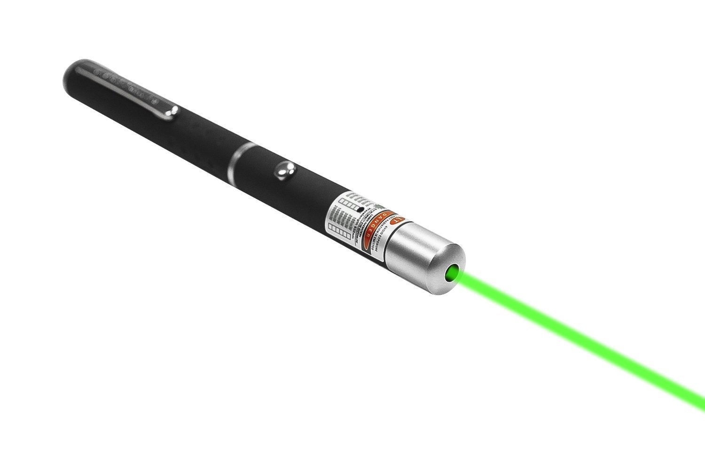
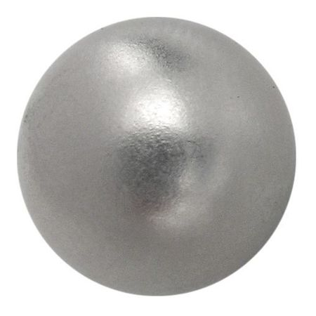
Demo
Notes:
Show off demo with magnetic ball, and a actual laser pointer, and even a screen door!

Slide 6
The Problem
Tons and tons and tons and tons and tons and tons and
tons and tons and tons and tons and tons and tons and
tons and tons and tons and tons and tons and tons and
tons and tons and tons and tons and tons and tons and
tons and tons and tons and tons and tons and tons and
tons and tons and tons and tons and tons and tons and
tons and tons and tons and tons and tons and tons and
This is very, very expensive computationally
tons and tons and tons and tons and tons and tons and tons and tons and tons and tons and tons and tons and tons and tons and tons and tons and tons and tons and tons and tons and tons and tons and tons and tons and tons and tons and tons and tons and tons and tons and tons and tons and tons and tons and tons and tons and tons and tons and tons and tons and tons and tons and tons and tons and tons and tons and tons and tons and tons and tons and tons and tons and tons and tons and tons and tons and tons and tons and tons and tons and tons and tons and tons and tons and tons and tons and tons and tons and tons and tons and tons and tons and tons and tons and tons and tons and tons and tons and of RAYS!
Notes:
Instead of saying this slide out lot, then calculate how 1000x1000 screen + 1000 objects is 1 billion rays per frame!
Imagine our 1000 x 1000 screen. That’s now 1 million rays shot out per frame!
We then must check each object to see if the ray intersects it, and figure out which object is the first to be intersected!
With 1000 objects, that’s already a billion operations per frame!

Slide 7


Shadows
Shadows are difficult. Ray tracing however, provides an easy solution to the problem.
Reflect a ray off the hit object.
Call this a Shadow Ray
No Shadow Shadow
Notes:
Once again, algo slides should have lots of text so people can read the algo, instead of just hearing it!
Shadows were an unsolved problem. Then go over text on slide
When a ray hits an object, emit another ray! Call this a shadow ray.
The shadow ray originates from the point the emitted ray hits the object, and goes to the light source.
We trace a ray from the point the emitted ray hits the object, to the light source!
If on the way to the light source, we hit an object, then we have something in the way!
In this case, our pixel is in shadow, so color accordingly.
Alas, this method requires tons more rays!

Slide 8
Reflections
Reflections are also difficult. Ray tracing thankfully also provides a solution!
However, much like shadows, this involves sending out many more rays!
Notes:
At the end of this slide, mention recursion.
Reflection was also an unsolved problem. Then go over text on slide.
When the slide mentions the reflection raying hitting another objec
After the whole slide
For influencing the color of the pixel, we usually use some reflection factor to weaken the color. Some constant value to multiply how much the object’s color has an effect on the pixel.
When a ray hits an object, emit another ray! Call this a reflection ray
The reflection ray originates from the point the emitted ray hits the object, and goes off at an angle. That angle is determined per object, and is the angle of refraction.
If we the reflection ray hits an object before a certain distance, then we use that object to influence how the pixel will be colored.
If we hit another object that is also reflective, then have to recursively continue, up to a certain depth.
Alas, Once again, tons more rays! !!!!!

Slide 9

Backward vs forward ray tracing
vs

Slide 10
Similar to how we view optics in real life
Just backwards!

Slide 11
History
Overview:
Rene Descartes (1637)
Arthur Appel (1968)
Turner Whitted (1980)
Robert L. Cook, Thomas Porter, Loren Carpenter (1984)
James Arvo (1986)
...

Slide 12
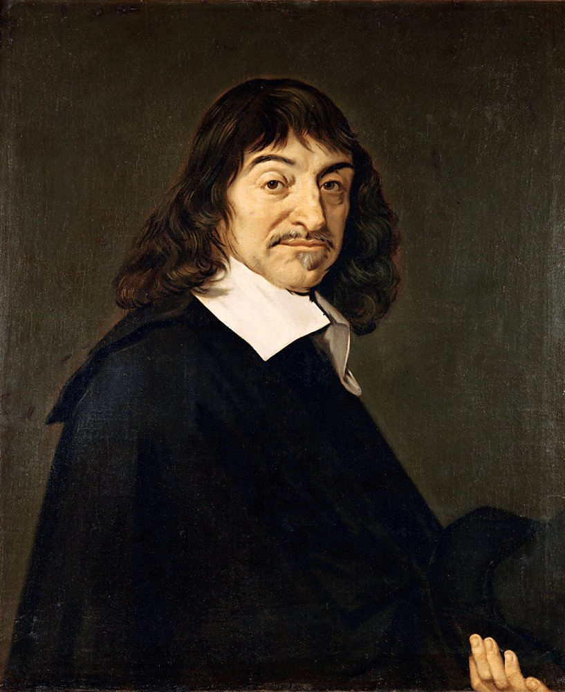
Rene Descartes
Dioptrics (1637)
Introduces the core concepts of ray tracing

Slide 13

Arthur Appel
Some techniques for shading machine renderings of solids (1968)
Applies ray casting techniques to rendering objects

Slide 14
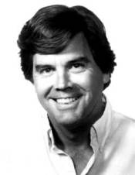
Turner Whitted
An Improved Illumination Model for Shaded Display (1980)
Introduces recursive ray tracing

Slide 15

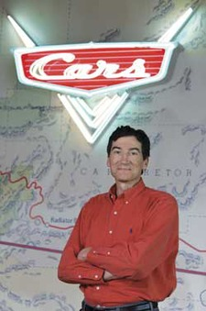
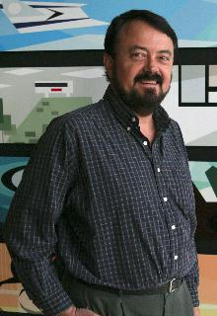
Robert L. Cook, Thomas Porter, Loren Carpenter
Distributed Ray Tracing (1984)
Robert L. Cook
Thomas Porter
Loren Carpenter

Slide 16
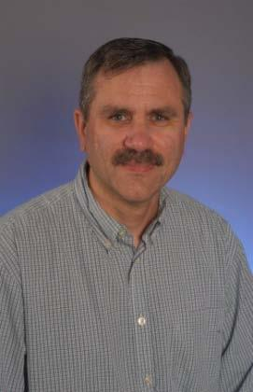
James Arvo
Backward Ray Tracing (1986)

Slide 17
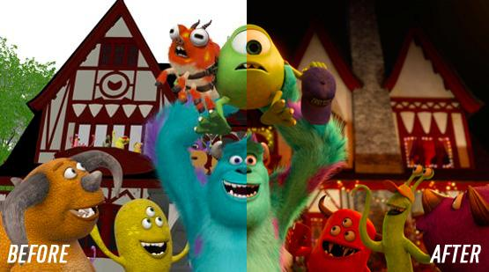
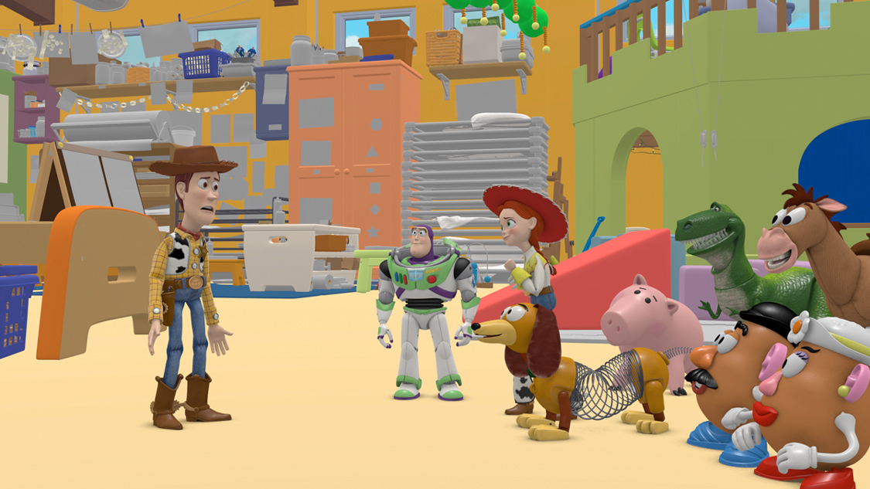
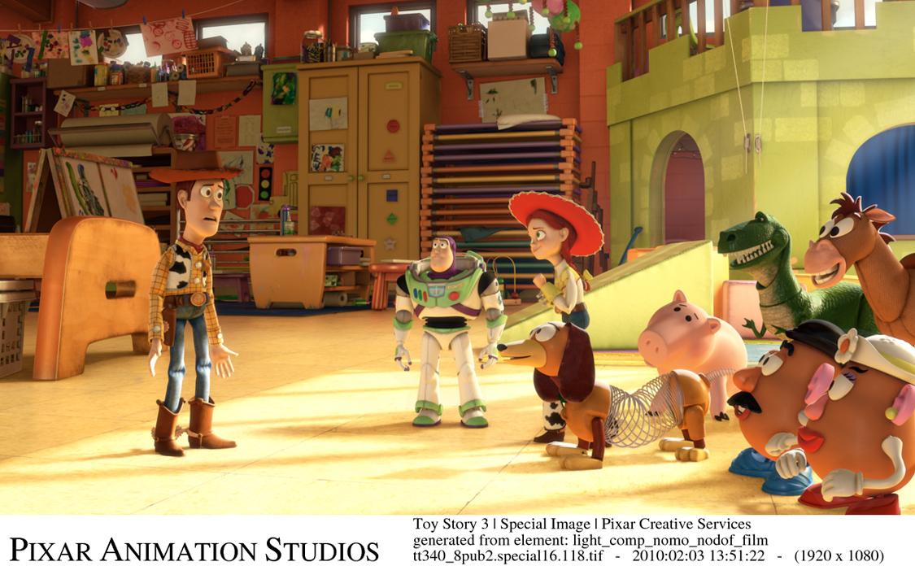
Raytracing in Film
-Global illumination
-Pixar’s Photorealistic RenderMan

Slide 18
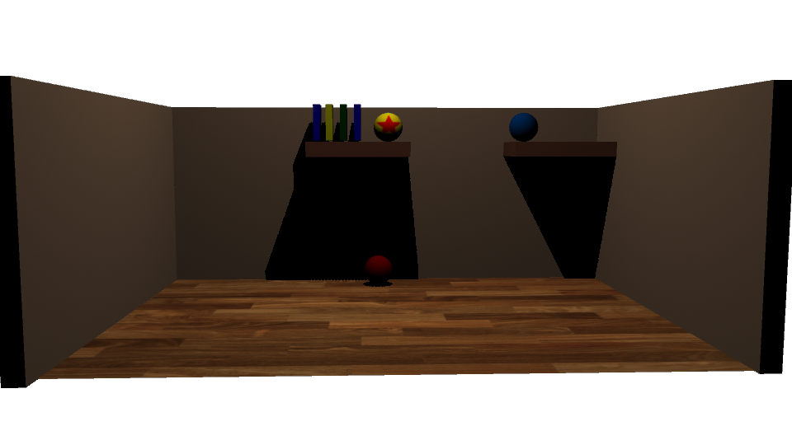
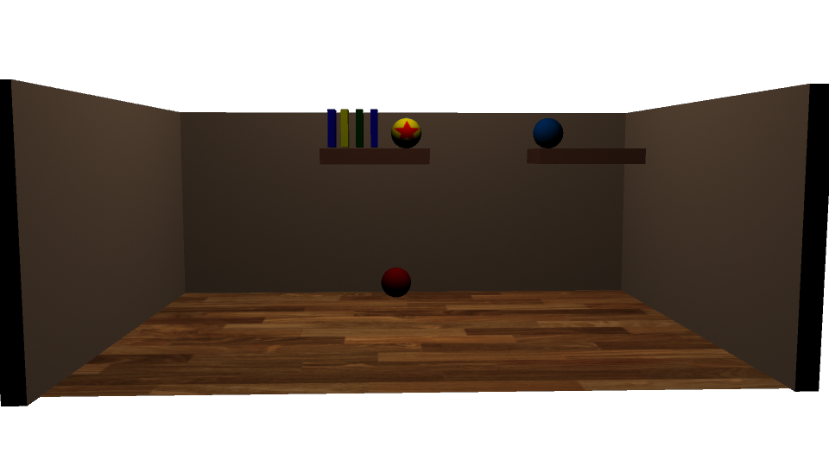
Raytracing in Autodesk Maya

Slide 19
References (History: Papers)
http://www.people.fas.harvard.edu/~jkmcdon/files/papers/Invited%20Articles%20and%20Contributions/06_Descartes%20Dioptrics%20and%20Optics%20together%20as%20single%20document.pdf
Cambridge paper discussing Descartes’ Dioptrics
http://graphics.stanford.edu/courses/Appel.pdf
Appel (paper)
https://excelsior.asc.ohio-state.edu/~carlson/history/tree/magi.html
MAGI (website)
http://citeseerx.ist.psu.edu/viewdoc/download?doi=10.1.1.107.3997&rep=rep1&type=pdf
Turner Whitted (paper)

Slide 20
References (History: Papers)
https://dl.acm.org/citation.cfm?id=808590
Distributed Ray Tracing (paper)
https://web.cs.wpi.edu/~matt/courses/cs563/talks/dist_ray/dist.html
More on Distributed Ray Tracing and its applications (WPI course page--more understandable than the paper)
https://pdfs.semanticscholar.org/c088/399ad6dc648647e0e19e01b5485925957681.pdf
James Arvo (paper)
https://graphics.pixar.com/library/HQRenderingCourse/paper.pdf
Ray Tracing and Photon Mapping (paper)

Slide 21
References (History: Images)
https://upload.wikimedia.org/wikipedia/commons/7/73/Frans_Hals_-_Portret_van_Ren%C3%A9_Descartes.jpg
Rene Descartes
https://fthmb.tqn.com/AhO2_ufNnC5S1iBHBuNV9Nc2yyE=/768x0/filters:no_upscale()/070715-Appel-58a29f175f9b58819c36ebe6.jpg
Arthur Appel (?)
http://hci.stanford.edu/courses/cs547/Resources/Pictures/whitted.jpg
Turner Whitted
https://en.wikipedia.org/wiki/Robert_L._Cook#/media/File:Rob_Cook.png
Robert L. Cook

Slide 22
References (History: Images)
https://alumni.stanford.edu/get/page/magazine/article/?article_id=32511
Thomas Porter
http://pixartimes.com/2014/01/14/the-pixar-perspective-on-loren-carpenter/
Loren Carpenter
http://senate.universityofcalifornia.edu/_files/inmemoriam/html/jamesrichardarvo.html
James Arvo

Slide 23
References
https://cs.stanford.edu/people/eroberts/courses/soco/projects/1997-98/ray-tracing/types.html
-Charity Lu, Alex Roetter, Amy Schultz
http://www.schorsch.com/en/kbase/glossary/raytracing.html
-Georg Mischler

